Slide 1
Strong Workforce
Round 3 Investments
Kelly Schelin
College Council
April 11, 2019
Notes:
Purpose = 2-fold: provide some background info about SWP (constitutes a sub investment in college’s career education programs) and seek this council’s approval on the college’s SWP plan.
Gauge level of knowledge in room
= 248 million investment in career education programs across the state.
Each college develops a local plan for how they will invest funds. These plans are submitted to CO and approved. As with so many grants that come from CO, the timeline for submission and approval is dramatically skewed. For this round, our plan is due June 1, 2018 and funding is retroactive to July 1, 2017…almost a full fiscal year off in terms of actual grant cycle, but more on that in a moment…

Slide 2
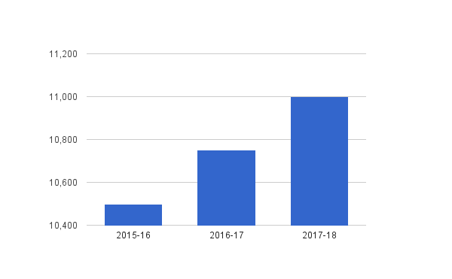
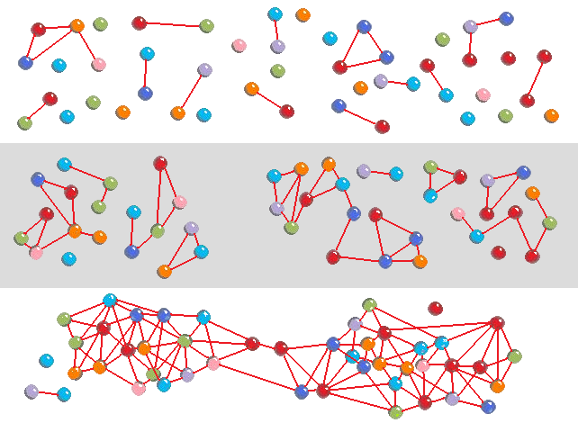
Strong Workforce Program Goals
MORE - Increase the amount of CTE instruction delivered (FTES, Headcount)
BETTER - Continuously improve CTE outcomes (Success, Completion, Job Placement, Job Retention, Wages,) with a particular focus on completion of industry valued credentials, job placement, and wage advancement
ALIGNMENT
Industry standards & needs
Career pathways (K-12, adult education, 4-year universities)
Notes:
Before going into the details of our plan, I’d like to provide some background info so that everyone understands the intent, and the limitations, of these funds
Can only be spent on CTE programs and services that will directly benefit CTE students
Primary goals = “more and better”. Basically, increase enrollments and improve quality.

Slide 3
Strong Workforce Program Metrics
“More & Better”
Size of CTE Programs (“more”)
Enrollments
Outcomes for CTE Programs (“better”)
Completion
Transfer
Employment
Employment in field of study
Second quarter earnings
Median change in earnings
Proportion of students who attained a living wage
Notes:
How we do on these metrics…how well we achieve the “more and better” goal, determines that 17% of performance-based funding. So nearly 1/5 of funding is performance-based.

Slide 4
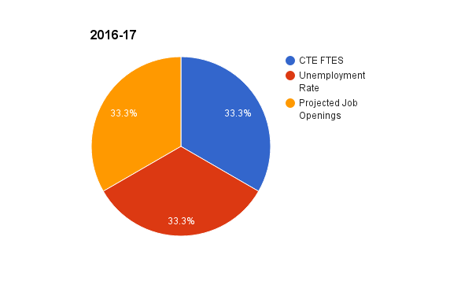
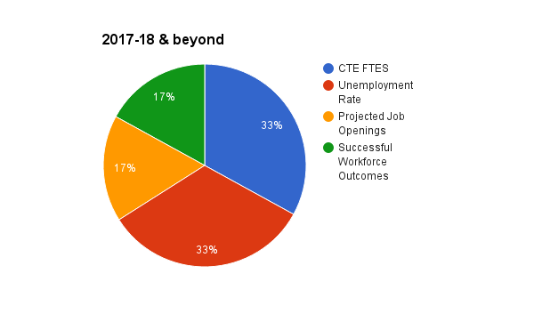
SWP Funding
12/31/18
12/31/19
FY 2016-17: 7/1/16 - 12/31/18
7/1/16
FY 2017-18: 7/1/17 - 12/31/19
7/1/17
FY 2018-19: 7/1/18 - 12/31/20
7/1/18
12/31/20
Notes:
Launched in 2016-2017. Each “round” lasts for 30 months, so the Round 3 funds, released in 2018-2019, can be spent through December 31, 2020. This 30 month cycle means that we have only just started spending R3 funds.
Highlight 17% of funding formula is based on the extent to which we achieve SWP outcomes.
1.3 in R1; just over 1.5 in Round 2 and Round 3.
Preparing to enter period with 3 overlapping funding cycles…

Slide 5
Round 3 Allocation
Local - $1,046,947
Regional - $493,607
TOTAL: $1,526,304
Types of Grants
Local Funds – Grants given to colleges that directly support local CTE programs and students
Regional Funds – Grants given to colleges to invest in regional infrastructure and common projects across colleges
Notes:
Total allocation…just over 1.5
Allocation split into two types of grants: local and regional

Slide 6
Allowable Uses of Funds
Increase quantity of CTE
Improve quality of CTE
Directed student services
Courses, programs, pathways, credentials (licensure), certificates, degrees
Requirement: labor market demand!
Provide career exploration, job readiness, job placement, work-based learning – leveraging Student Success/Students Equity funds, Local Workforce Investment Board resources, etc.
Notes:
So…how can we use this $? As I indicated earlier, only CTE programs and supports. But, only some CTE programs quality because we need to justify that there is labor market demand in order to be able to invest in each program. Need to show that there will be jobs for students. So, very easy to justify say nursing or medical assisting because the demand for these positions is consistently growing…very easy to justify supporting our FLOW program.
- Tougher with Early Childhood and Culinary. Childcare and hospitality jobs form the bedrock of our economy, but students don’t typically earn a living wage and, in the case of culinary, often a certificate or degree is not required, so it is harder to make the demand argument. Fund these programs out of other funding streams.

Slide 7
Application & Allocation Process
Input from CTE Committee investment strategies and categories
CTE faculty complete Annual Plan/Program Review
CTE faculty complete two-page application for CTE funding (SWP, Perkins, etc.)
Collaboration with marketing, outreach, student services, HSI STEM, integrated plan, etc.
Dean of Workforce Development creates a proposal for how to meet program needs by leveraging various funding streams
CTE Committee reviews and approves proposal
College Council reviews and approves proposal
Notes:
= process that we went through as an institution to determine how these funds would be allocated. It’s important to realize that the planning around this investment does not happen in a vacuum. CTE Committee played a huge role in this process.
Recognition that some programs cost more to operate than others. We’ve explored this in detail and there is acceptance that it simply does not make sense to fund everyone at the same level.

Slide 8
Round 3 Investment Strategy
Notes:
So…how can we use this $? As I indicated earlier, only CTE programs and supports. But, only some CTE programs qualify because we need to justify that there is labor market demand in order to be able to invest in each program. Need to show that there will be jobs for students. So, very easy to justify say nursing or medical assisting because the demand for these positions is consistently growing…very easy to justify supporting our FLOW program.
- Tougher with Early Childhood and Culinary. Childcare and hospitality jobs form the bedrock of our economy, but students don’t typically earn a living wage and, in the case of culinary, often a certificate or degree is not required, so it is harder to make the demand argument. Fund these programs out of other funding streams.

Slide 9
Program-Level Investments
Program Area | Type of Investment | Amount
Administration of Justice | Laptops and equipment | $15,000
Automotive Services | Release Time for T-Ten Coordinator(s), evening Instructional Asst., equipment for Toyota T-Ten Program | $290,030
Business | 1 FT Faculty – 70% (Round 1 investment) | $64,000
Business Office Tech/ Computer Information Systems | 1 FT Faculty – 70% (Round 1 investment) | $93,000
Forklift & Logistics (FLOW) | PT Faculty, Instructional Assistant, Equipment | $45,000
Medical Assisting | Release Time for Accreditation prep EHR licensing & equipment/supplies | $30,000
Nursing | 1 FT Faculty – 70% (Round 1 investment) PT Faculty for additional cohort Instructional Equipment | $116,000
Paramedic | Release time for Program Director Medical Director & Consultant | $106,000
Notes:
= snapshot. Recognition that accounts for roll-over from Round 1. Does not account for investments being made out of Perkins…goal is to touch all CTE programs & areas of the college that support CTE students

Slide 10
Across Program Investments
Description | Type of Investment | Amount
Career Center | % of Coordinator and program asst. Funds to renovate space Supplies & subscriptions | $104,700
Guided Pathways | Faculty release time & OAS Materials & Consultants | $30,000
K-14 Pathways | Early College Credit Coordinator (%) Support staff & materials | $65,000
Marketing & Outreach | Marketing materials & multi-media ad buys, content writer/website support, Outreach Manager (%) | $80,800
Professional Development & Travel | PD Funds for CTE faculty & staff | $15,000
Support Services/ CBO Partnerships | SparkPoint San Pablo EDC (internships) | $30,000
Workforce Development. Department | Partial salaries for dean and manager, travel expenses, supplies | $128,884
Notes:
= snapshot. Recognition that accounts for roll-over from Round 1. Does not account for investments being made out of Perkins…goal is to touch all CTE programs & areas of the college that support CTE students

